Slide 1


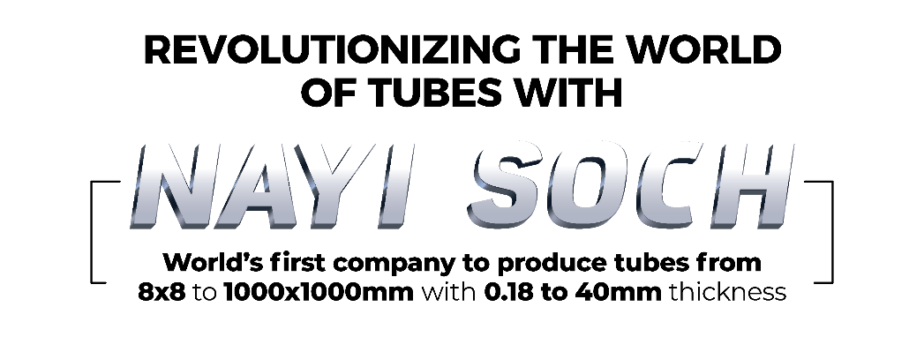
October 2023

Slide 2
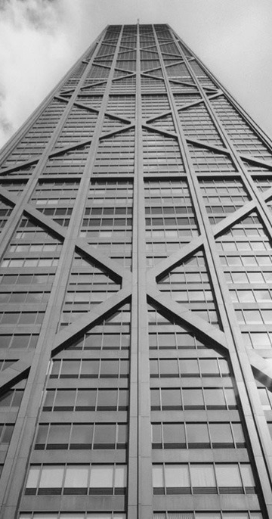
Safe Harbour
Except for the historical information contained herein, statements in this presentation and the subsequent discussions, which include words or phrases such as "will", "aim", "will likely result", "would", "believe", "may", "expect", "will continue", "anticipate", "estimate", "intend", "plan", "contemplate", seek to", "future", "objective", "goal", "likely", "project", "should", "potential", "will pursue", and similar expressions of such expressions may constitute "forward-looking statements“. These forward looking statements involve a number of risks, uncertainties and other factors that could cause actual results to differ materially from those suggested by the forward-looking statements. These risks and uncertainties include, but are not limited to our ability to successfully implement our strategy, our growth and expansion plans, obtain regulatory approvals, our provisioning policies, technological changes, investment and business income, cash flow projections, our exposure to market risks as well as other risks. The Company does not undertake any obligation to update forward-looking statements to reflect events or circumstances after the date thereof.
APL APOLLO TUBES

Slide 3

Contents
APL Apollo Overview
Core Competence
Structural Steel Tubes Applications
Business Strategy
New Initiatives
ESG Engagement
Financial Perfromance
Team APL Apollo
APL APOLLO TUBES

Slide 4

APL APOLLO OVERVIEW
APL APOLLO TUBES

Slide 5





APL Apollo at a Glance
01 Leading Structural Steel Tube Brand
14 Brands, Four Product Categories
55% Market Share
3.6 Million Ton, Structural Steel Capacity
16
Patents
11
plants
2,587
Employees
800+
Distributors
APL APOLLO TUBES
2,500+
Products
*Market share is for H1FY24

Slide 6
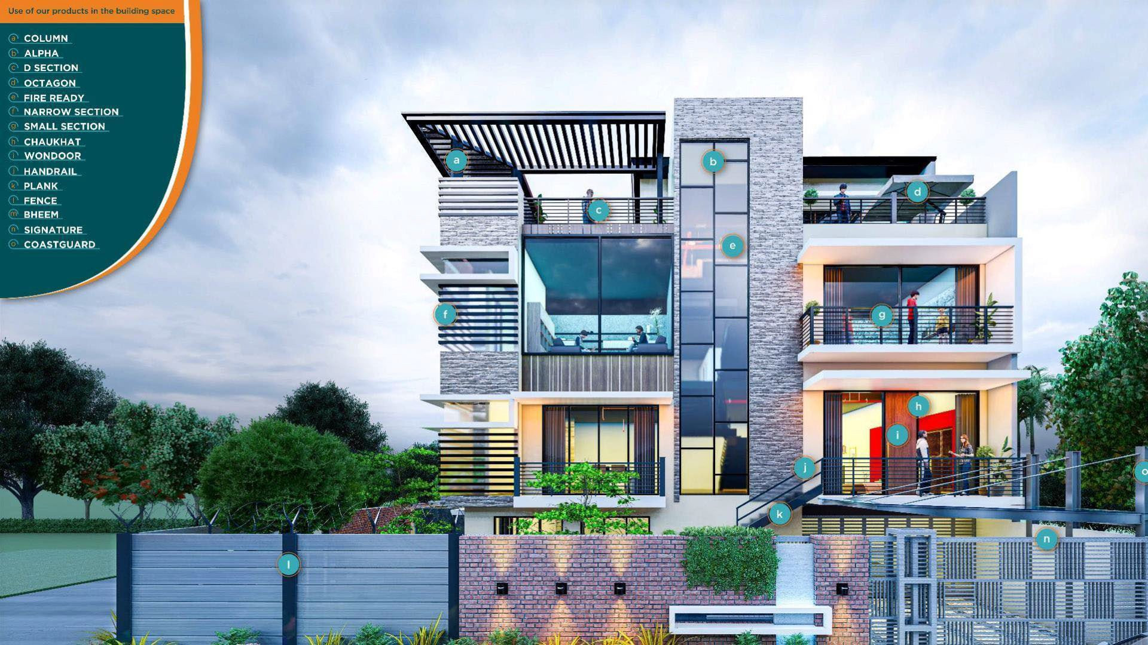
India’s Leading Building Material Brand

Slide 7
Our Brands
79%
Apollo Structural
Fabritech, Build, DFT, Column, FireReady, Agri
Plank, Signature, Elegant, Chaukhat
Structural steel construction material: Residential, Commercial, Infrastructure
Building Material
Apollo Z
Galvanized structural steel construction material: Residential, Commercial, Infrastructure
Coated products
CoastGuard
18%
Infrastructure
APL APOLLO TUBES
Apollo Galv
Galvanized steel tubes:
Residential, Commercial, Agri, Industrial
Green, Bheem, Z+
3%
Others
*Apollo Structural - Hollow Se ction & Bla ck Round , Apollo Z – Coated & Pr e Ga lva nize d (GP), Apollo Ga lv – Ga lva nize d (GI)

Slide 8
Product Application & Sales Mix*
Product Category | Sales Volume Mix (%) | Applications
Apollo Structural | 70%
Residential Buildings & Independent Homes | 45% | Structural, Piling, Sheds, Handrails, Gates, Fencing, Balcony Grills, Staircase, Light Structures
Infrastructure | 19% | Structures for Metros, Airports, Stadiums, Stations etc
Commercial Buildings, Warehouses & Factories | 16% | Heavy Equipment for construction
Apollo Z | 25%
Residential Buildings & Independent Homes, Commercial Buildings, Warehouses & Factories | 21% | Galvanized structural steel tubes for coastal Markets
Commercial Buildings, Warehouses & Factories | 4%
Apollo Galv | 5%
Commercial Buildings | 4% | Galvanized Structural, Greenhouse Structures, Plumbing, Firefighting
Industrial & agriculture | 1%
Total | 100%
57%
Building Material housing
22%
Building Material Commercial
APL APOLLO TUBES
18%
Infrastructure
3%
Others (Industrial & Agri
*As per Q2FY24 Sales Volume

Slide 9
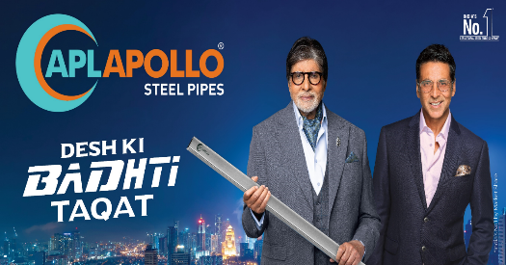
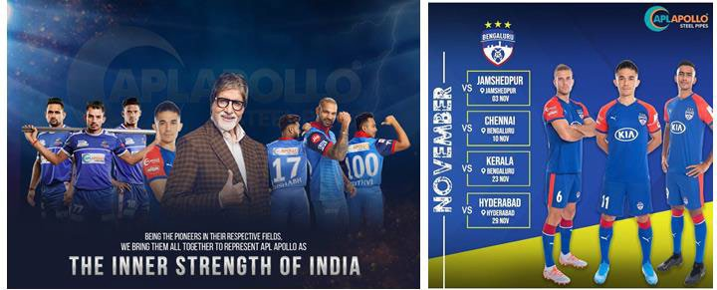



Brand Equity
APL APOLLO TUBES

Slide 10
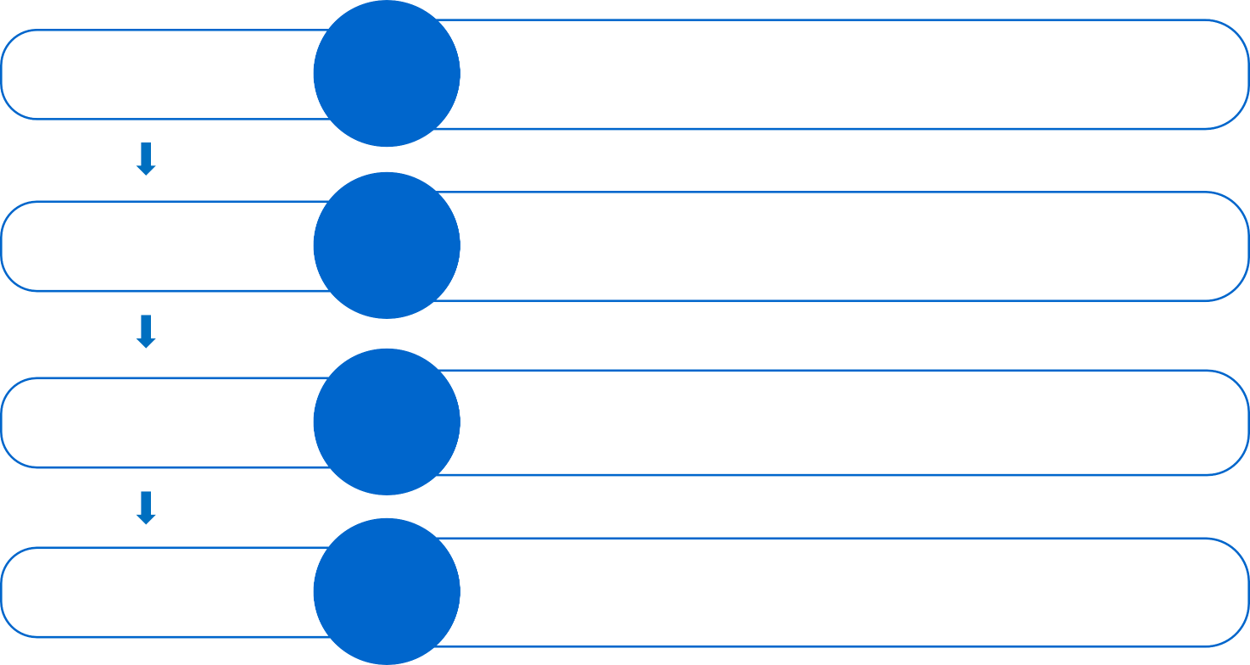
B2C Channel
DISTRIBUTORS
800+
Solid Relationships, Incentive plans
RETAILERS
50,000+
Retailer bonding program
APL APOLLO TUBES
FABRICATORS, ARCHITECTS & ENGINEERS
2,00,000+
Apollo Connect Programs, Fabricator/Architect meets for Brand promotion
CONNECT THROUGH
Indian Premier League, Football, Kabaddi League, Amitabh Bachchan Campaign, TV Commercials, Radio, Social Media
END CONSUMER

Slide 11
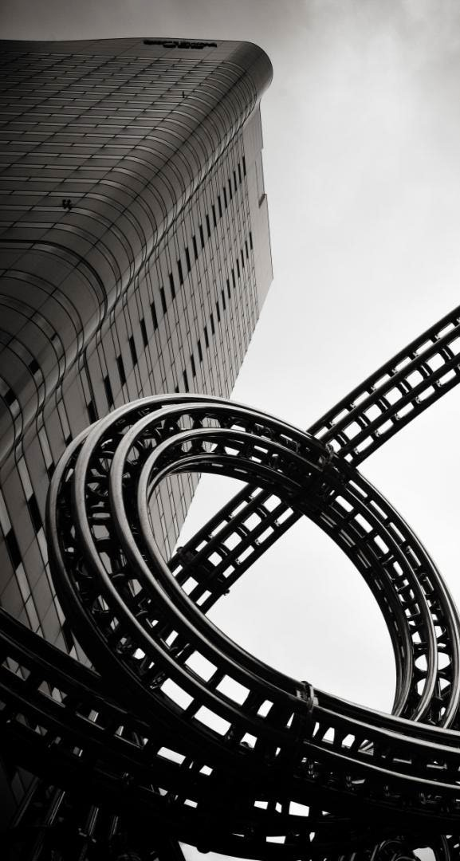
CORE COMPETENCE
APL APOLLO TUBES

Slide 12
Porter’s Five Forces
Threat of Entry
Bargaining power of distributors
Scale of 3.6 Mn ton capacity; wide gap between No. 2 Player
Vast distribution network (access to 800+ distributors, 50,000 retailers, 200k fabricators)
Technology advantage (DFT, ILG)
Lowest cost producer
(highest profitability in the sector)
Product range (2,500+ SKUs)
Lead time to distributors (48hrs delivery)
Financial strength (doubling capacity every 3rd year without debt)
Unmatched brand strength
55% market share in structural steel tubing industry
Monopoly products (new innovative products)
APL Apollo distributors can churn capital upto 8x in a year which helps them generate high ROCE
Industry Rivalry
APL Apollo 55% market share
Player 2 - 10% market share (ancillary business for steel producer)
Player 3 - 10% market share (focus on water transportation and Oil &Gas tubes)
Player 4 - 7% market share (strong player but small in Parent’s overall scheme of things)
Player 5 - 7% market share (focused in East market; regional player)
Player 6 - 6% market share (high debt)
Player 7 - 3% market share (high debt)
Player 8 - 2% market share (poor profitability)
Others – 1%
Threat of substitute
APL APOLLO TUBES
Bargaining power of suppliers
No product can replace structural strength of steel
Company buys 2% of Indian steel production and 10% of Indian HR coil production
Amongst Top 3 customers for large steel producers
Company’s steel buying price is minimum in structural steel tubing industry

Slide 13

Our Business MOAT...
Highest no. of products
with 2,500 SKUs
Lowest cost producer (largest buyer of HR coil)
Highest scale with 11 plants (3.6 Mn ton capacity)
Premium pricing to peers (brand strength)
Highest Profitability
APL APOLLO TUBES
Largest sales network (800+ distributors)
Technology edge & Innovation
Lowest lead time for delivery to distributors

Slide 14
Dominant Leadership
Peer Market Share H1FY24
11%
7%
7%
APL Apollo Player 1
Player 2
Player 3
Player 4 Others
10%
55%
10%
APL APOLLO TUBES

Slide 15




Unique Capabilities
Developed structural steel
market in India
Technology
Distribution network
Innovative products
APL APOLLO TUBES
First Mover advantage
Direct Forming Technology for big structural products
In-line Galvanizing to replace traditional products
B2C channel for last mile penetration
Ground breaking solutions
No.1 Leader; Focused on steel strength and building material applications
Roofing solutions for coastal market, door frame

Slide 16
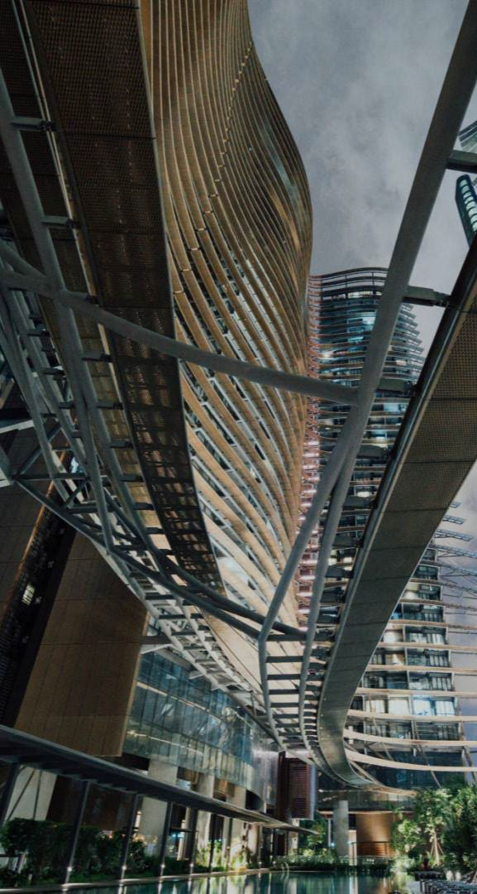
STRUCTURAL STEEL TUBES APPLICATIONS
APL APOLLO TUBES

Slide 17
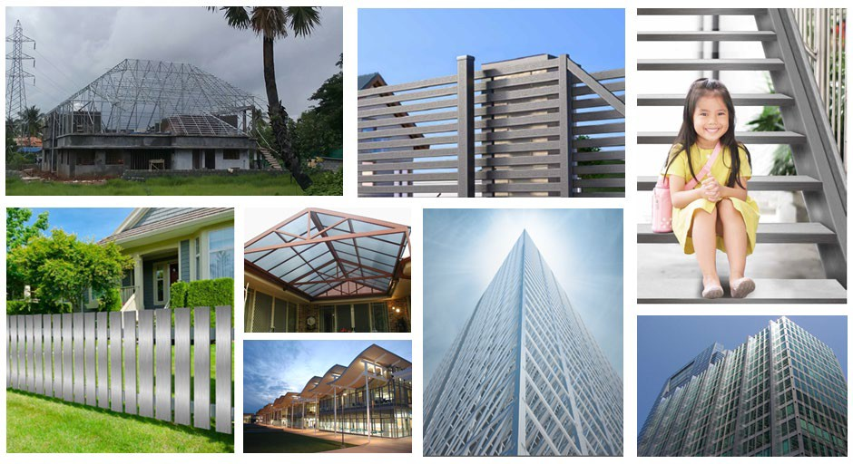
Structural Steel Applications
APL APOLLO TUBES

Slide 18
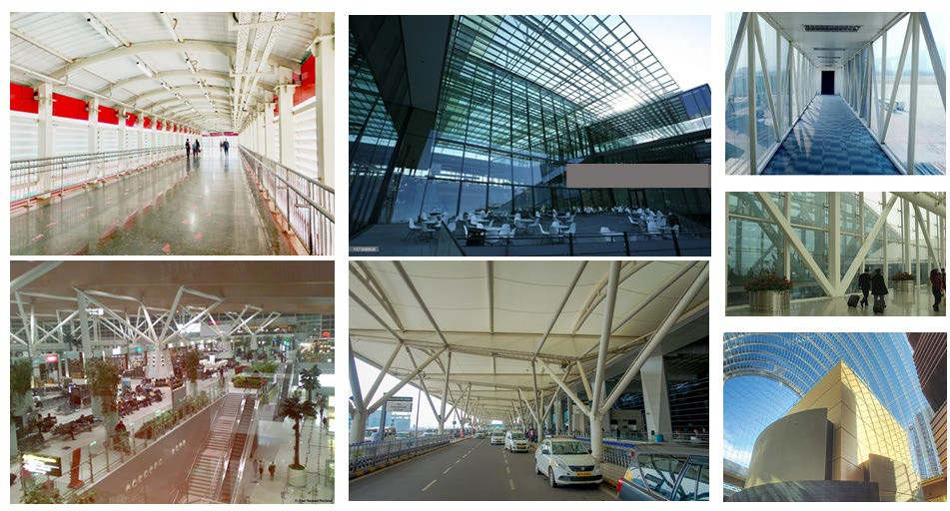
Structural Steel Applications
APL APOLLO TUBES

Slide 19


Capex Plan for value addition
Distribution Enhancement
BUSINESS STRATEGY
APL APOLLO TUBES
Market Creation
Innovation

Slide 20







APL Apollo Vision
MARKET CREATION
INNOVATION
+
ESG
+
Solid new product pipeline
Complete product
portfolio for steel buildings
Innovative processes which improve life of steel
Replacement of conventional construction products
  Wood
  Angles/Channels
  RCC
Reach out program for influencers: Fabricators, Architects, Structural Engineers
Introducing environmentally friendly products
To reduce the emissions by 25% by 2030
Working Towards gender diversity
Focus on CSR towards local communities
New Code of conduct implemented for all employees
APL APOLLO TUBES

Slide 21

INNOVATION
World’s only company to make steel tubes with size range of 8x8mm to 1000x1000mm and thickness range of 0.18 mm to 40mm
APL APOLLO TUBES

Slide 22
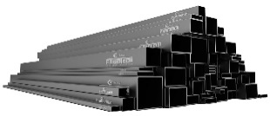
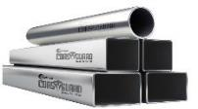
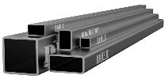
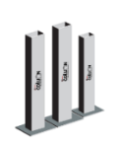
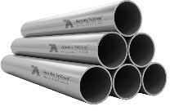
What we have done so far as the first company
Indian Markets
Structural steel square and rectangular tubes:
Structural application in construction Industry
Pre-galvanized structural steel tubes (Apollo Z):
Corrosive resistant structural applications
DFT (Direct Forming Technology)
Faster TAT with tailor made sizes
APL APOLLO TUBES
300x300mm dia structural steel tubes:
Heavy structural application in Construction industry
Inline galvanizing (ILG)
Superior corrosive resistant product strong demand in coastal market

Slide 23

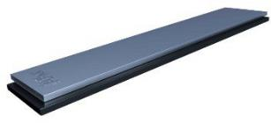
What we have done so far as the first company
Global Markets
Chaukhat (Door frame shape tubes)
Replacing Conventional wooden door frames
Rectangular section of 1:11 (Length to Breadth)
Replacing Conventional wooden sections
APL APOLLO TUBES

Slide 24
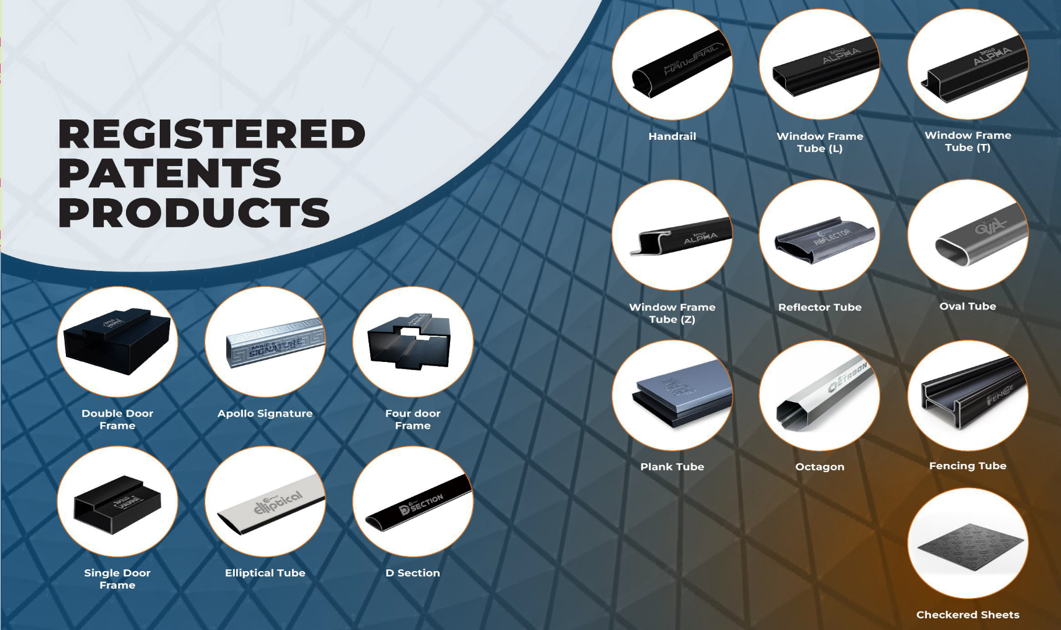
APL APOLLO TUBES

Slide 25

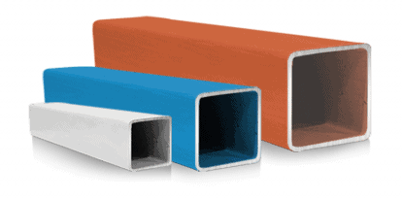
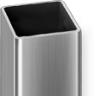

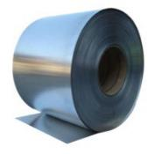
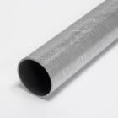
New Product Pipeline from Raipur plant
World’s 1st thicker color coated products
Superior corrosion resistant, high load bearing with aesthetics
World’s 1st Color coated structural steel tubes
Superior corrosion resistant with aesthetics
India’s 1st 500x500mm dia structural steel tubes
Replacing RCC structures/columns in heavy construction
India’s 1st and World’s 2nd 1,000x1,000mm
APL APOLLO TUBES
India’s 1st CRCA Black annealed tube
High tensile light structural application; bendable; superior rust proof properties
India’s 1st AluZinc tubes
Superior rust proof properties and better life

Slide 26
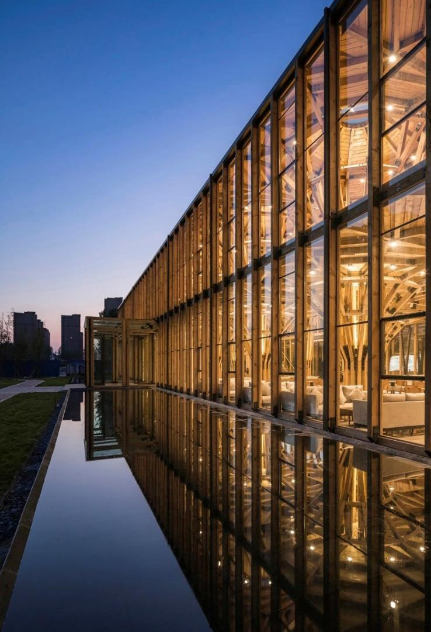
MARKET CREATION
APL APOLLO TUBES

Slide 27
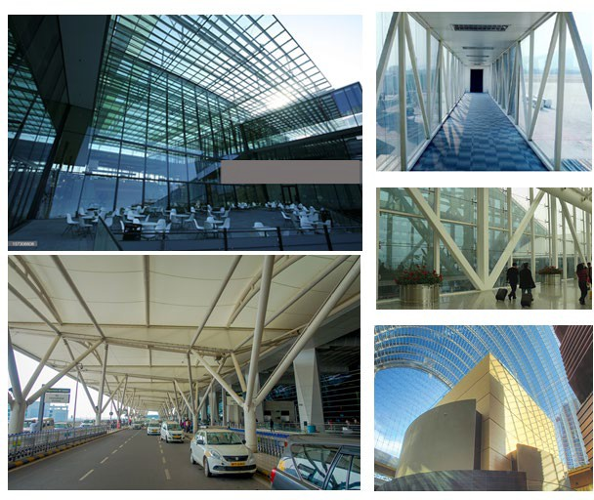
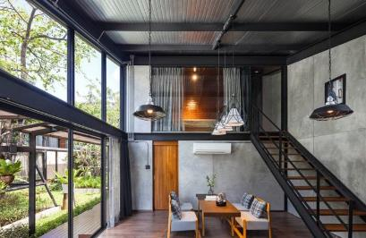
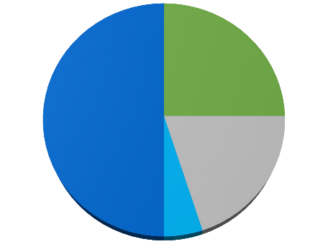
Structural Steel Tube Applications
Application Mix
Commercial Buildings 25%
Housing 50%
APL APOLLO TUBES
Infrastructure 20%
Others 5%
*As per H1FY24 revenue

Slide 28
How Have We Created Market..
Conventional Construction Products | Applications | Why Structural Steel Tube replaces these products?
Steel Angle/Channels | Structural support, Towers infrastructure | Uniform Strength, Lower steel consumption
Wood | Furniture, Door Frames, Planks | Cost Effective, Termite Proof, Environmental Friendly
Aluminum Profiles | Facades & Glazing | Cost Effective, Higher Strength
Reinforced Cement Concrete | Construction of Buildings | Faster Construction Environmental Friendly
Fabricated Metal Sheet | Pre-Engineered Steel Buildings | Lower steel consumption Reduces overall project cost
How to replace the conventional products??
Low Diameter Steel Tubes/Low Load
Bearing
APL APOLLO TUBES
High Diameter Steel Tubes/High Load Bearing

Slide 29
REVOLUTIONIZING CONSTRUCTION INDUSTRY
APL APOLLO TUBES

Slide 30

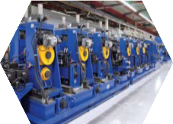
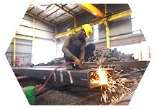
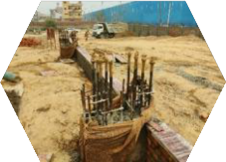
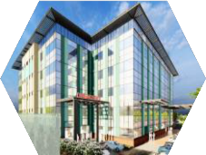


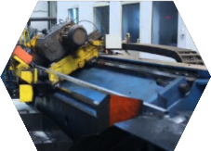
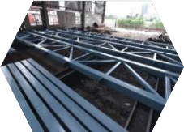
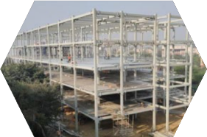
Tubular Construction Process flow
Tube Manufacturing
Fabrication
Tubes are sand blasted, then
connected using
connectors
Civil Foundation
Hospital Building
Hospital
Production of 6,000 ton ERW tubes per day at plants of APL
Apollo
Civil Foundation & Arrangement of anchor bolts at site to install
tube columns
Transfer of cut to length tubes to Fabricator’s workshop
Transfer of structure parts to the site
APL Apollo Tubes
CTL Line
Cutting of tubes into desired length at APL Apollo plant to
minimise wastages
Painting
Connected structures are
painted
Site Erection
Zero on-site fabrication/Welding; Erection using bolting connections

Slide 31
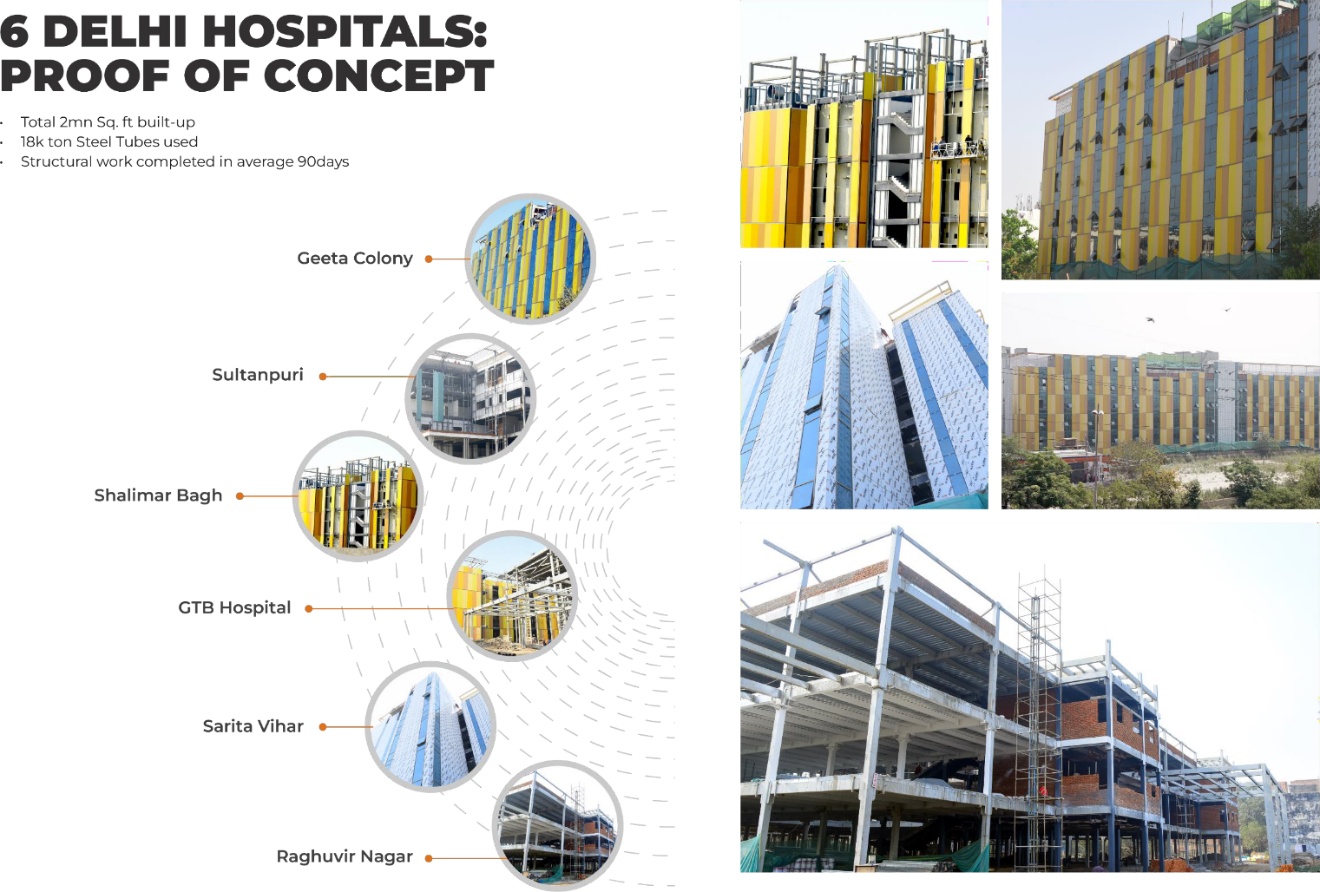
APL APOLLO TUBES

Slide 32
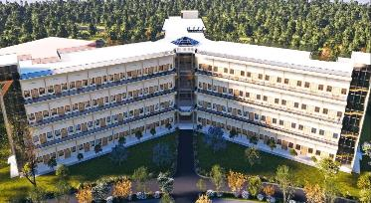
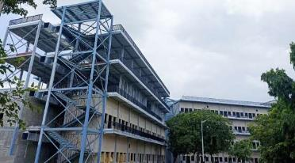
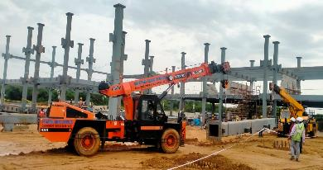
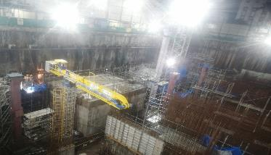
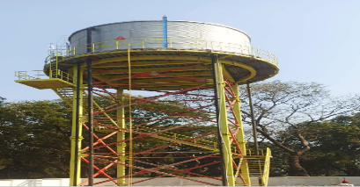
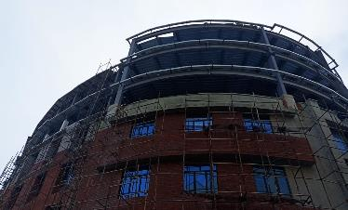
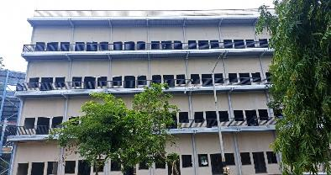
More live sites
MES – Delhi Cantonment
University Campus- Telangana
APL APOLLO TUBES
Railway Station – Andhra Pradesh
Hospital- Mumbai
Water Tank, Uttar Pradesh
University, Delhi NCR
Housing-Delhi

Slide 33
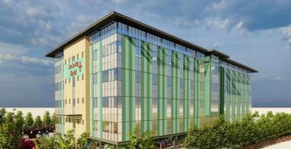
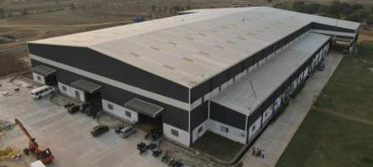
Applications
High Rise Buildings
Hospitals, Housing, Schools, Courts, Hotels/Malls/Offices
45
projects
42mn sq. ft.
Visibility
220,000 ton
heavy structural steel tubes
Warehouses/Cold Storage/Food Parks
Factory Buildings/Process Structures
Aviation Hangers
Data Centres
Ongoing enquiries
APL Apollo Tubes

Slide 34
Vision 2025
Dominant position with 60%+ market share
Company aims to continue its dominant position in Indian Market
Capacity: 5 Mn Tons with Capacity Utilization of 80%+
1
Product innovation
Create formidable position in newer product category (Super Heavy and Coated)
Revenue 2X
2
Strengthen presence in Global Markets
Aim to enhance global presence and have 10% share of the overall sales
EBITDA 2.5X
3
APL APOLLO TUBES
Customer Centricity
With Investment in B2C app, use of Bollywood and Sports for brand pull, we have strong focus on customer centricity
70%+ revenue from Value Added Products
4
Recognized Player on ESG Front
Significant focus on ESG
10%+ of sales from Exports
5

Slide 35



Growth Drivers
A
Capacity expansion
B
New products
C
Focus on high margin products
D
Geographic expansion
Raipur project
Capacity: 1.2 MTPA (infrastructure of 1.5 MTPA)
Capex: Rs13bn (90% already incurred)
Potential financials:
  Revenue: Rs70bn+
  EBITDA: Rs6bn+
Products
Project specifically focused at High- value added products 3 key product categories:
High Diameter High Thickness Tubes
500m x 500m and 1000m x 1000m
Capacity: 0.42 MTPA
Suitable for high rise, high load bearing structures
Reduces project cost by ~20% for the developer
Coated Tubes
Colored and galvanized
Capacity: 0.36 MTPA
Suitable for Warehousing, infrastructure & industrial segments
Coated Products
Narrow cold rolled and flat products
Capacity: 0.42 MTPA
New age products to replace existing products of wood, PVC etc.
East India
Capacity: 0.18 MTPA
Project to help deeper penetration in the Eastern India market
Land acquisition in process
COD: FY 25
Dubai
Capacity: 0.3 MTPA
First plant outside India for catering to Middle East and European markets
COD: FY 25
APL APOLLO TUBES

Slide 36
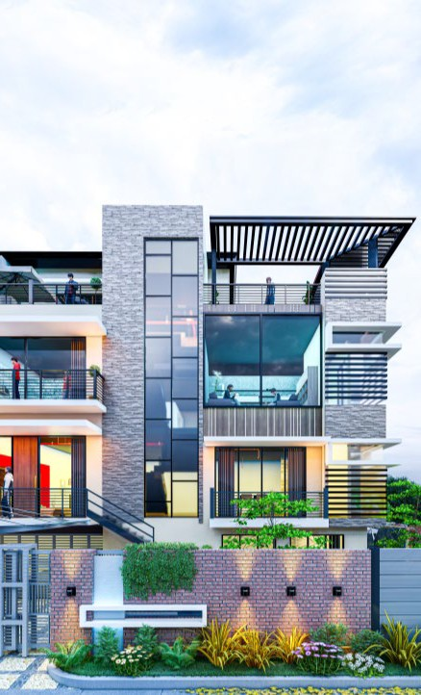
NEW INITIATIVES
APL APOLLO TUBES

Slide 37

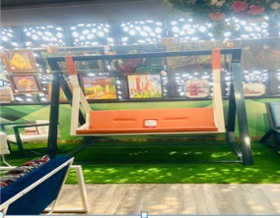
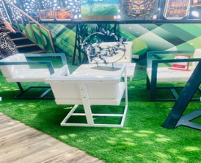
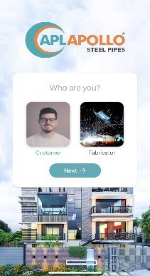

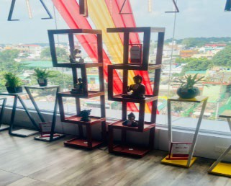
B2C Tech App
APL APOLLO MOBILE - APPLICATION LAUNCHED
40,000+ Fabricators enrolled
340,000+ Total Downloads
400+ Designs
16 Patents registered
APL APOLLO TUBES

Slide 38

APL Apollo’s ESG Transformation
Journey

Slide 39
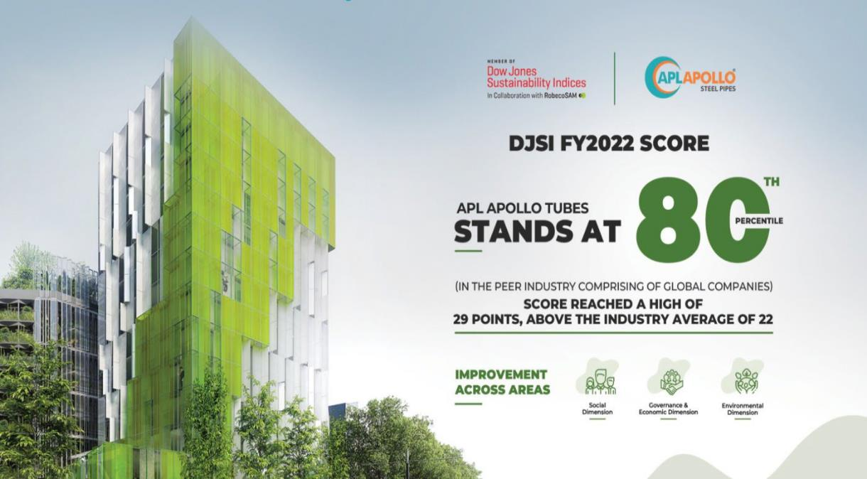
DJSI Scoring
APL APOLLO SCORED 80TH PERCENTILE IN FY23
We expect better score this year as we are improving on ESG parameters

Slide 40
Commitment and achievements
Commitments
Achievements
Committed to reducing Scope 1&2 emissions by 25% by 2030
E
Introduced new, environmentally friendly products
E
Committed to set near term and Net Zero targets by 2050
E
All plants have access to green energy, 2 plants have more than 85% dependency on green energy
E
Renewable energy contribution to be 47% by 2030 from 38%
E S S
S S S S
Almost all plants have rainwater harvesting facilities
Zero accidents by providing safety training at sites
Attrition rate below 5%
Hiring female workforce to achieve gender diversity targets
Targeted to increase the female workforce by 1% every year
APL APOLLO TUBES
CSR initiatives in the local communities to uplift their lifestyle
Skill development trainings and safety trainings
S S
Occupational Health and safety assessment of all work force
S
Given emphasis to CSR initiatives in local communities
Training on code of conduct to educate each employee
G
New Code of conduct implemented for all employees
G

Slide 41



ESG Developments
Assessed Scope 3 emissions (in addition to Scope 1 & Scope 2)
Safety Manual formulated for all the production facilities and offices
New Human Rights policy incorporated
APL APOLLO TUBES
Code of Conduct: New Code of conduct is formulated for all employees

Slide 42
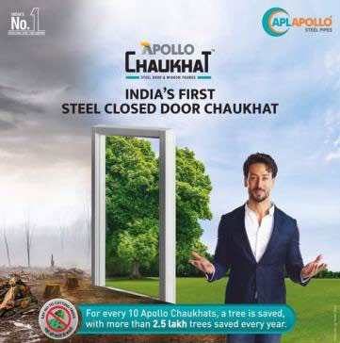
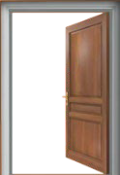



Front runner for Steel for Green
APL Apollo is the 1st Company to innovate readymade Chaukhat, Fence, Plank and Hand rails as Steel for Green Concept which replaced conventional wood application in building construction
Our Products are saving 250,000 trees every year, going ahead we will be saving more and more trees to keep the planet greener
Keeping the Steel for Green as priority APL is the 1st Company to innovate narrow and thicker color coated galvanized sheets which will save more trees
APL Apollo Tubes

Slide 43


Steel Buildings = Decarbonization
Construction sector contributes 30% of direct and indirect Co2 emissions
Structural steel is preferred for steel buildings because steel is
  Infinitely recyclable
  Easy to pre-fabricate
  High volume to weight ratio
  Lighter/ stronger structure allow gains inn vertical space
Research indicates replacing reinforced concrete with steel structures can reduce emission by 60%
Steel Structure - RCC Structure
APL Apollo Tubes

Slide 44

FINANCIAL PRIORITIES & PERFORMANCE
APL APOLLO TUBES

Slide 45
Financial Priorities Under Strong Governance
Growth
Earnings
Drive sustainable EPS growth Attain earnings objectives across economic cycles
Profitable Organic Growth Commitment to R&D and Talent Innovate products to replace conventional construction methods
APL APOLLO TUBES
Capital Allocation
Drive sustainable EPS growth
Attain earnings objectives across economic cycles
Achieve ROCE ≥ 30%

Slide 46
Growing Strength to Strength
Sales Volume CAGR(FY13-23) 18%
APL APOLLO TUBES
Note 1: This data is based on the Consolidated Financial data of the Company;
Note 2: Sales Volume and Financials are on consolidated basis and Net Profit is after Minority Interest

Slide 47
Growing Strength to Strength
APL APOLLO TUBES
Note1: Capital employed for ROCE is computed as Total assets less Current Liabilities & Cash
Note 2: ROE/ ROCE has been annualized on H1FY24 basis

Slide 48
Growing Strength to Strength
APL APOLLO TUBES

Slide 49
Growing Strength to Strength
APL APOLLO TUBES

Slide 50
De-commoditizing Product Portfolio
Product Category | Application | FY20 |  |  | FY21 |  |  | FY22 |  |  | FY23 |  |  | H1FY24 |  |  | Existing capacity | Proposed Capacity
 |  | Sales Mix | Vol. | EBITDA/Ton | Sales Mix | Vol. | EBITDA/Ton | Sales Mix | Vol. | EBITDA/Ton | Sales Mix | Vol. | EBITDA/Ton | Sales Mix | Vol. | EBITDA/Ton | (KTon) | (KTon)
 |  | (%) | (KTon) | (Rs) | (%) | (KTon) | (Rs) | (%) | (KTon) | (Rs) | (%) | (KTon) | (Rs) | (%) | (K Ton) | (Rs)
Apollo Structural | Heavy | 6 | 101 | 4,000 | 6 | 95 | 4,721 | 7 | 121 | 7,422 | 7 | 160 | 7,505 | 7 | 96 | 8,121 | 300 | 396
 | Super Heavy | - |  |  | - |  |  | - |  |  | 0 | 2 | 9,604 | 1 | 9 | 9,422 | 100 | 186
 | Light | 8 | 134 | 4,778 | 21 | 352 | 5,649 | 19 | 336 | 6,683 | 18 | 407 | 5,134 | 17 | 223 | 6,019 | 905 | 1,500
 | General | 55 | 898 | 1,361 | 43 | 713 | 1,658 | 37 | 647 | 2,212 | 44 | 1,005 | 2,015 | 44 | 583 | 2,200 | 1,200 | 1,473
Apollo Z | Rust-proof | 25 | 401 | 5,279 | 25 | 409 | 6,692 | 33 | 575 | 7,710 | 25 | 567 | 7,214 | 23 | 313 | 6,736 | 675 | 825
 | Coated | - |  |  | - |  |  | 0 | 0 |  | 2 | 39 | 5,731 | 4 | 48 | 6,089 | 300 | 300
Apollo Galv | Agri/Industrial | 6 | 99 | 3,952 | 4 | 71 | 6,040 | 4 | 76 | 6,442 | 4 | 99 | 5,667 | 5 | 63 | 6,711 | 120 | 320
Total |  | 100 | 1,633 | 2,923 | 100 | 1,640 | 4,138 | 100 | 1,755 | 5,386 | 100 | 2,280 | 4,481 | 100 | 1,336 | 4,731 | 3,600 | 5,000**
Standard products with EBITDA around Rs 2,000/ Ton
Value added products with EBITDA more than Rs 5,000/Ton
*ABPL (New Raipur) products have been re-classified in heavy, Super Heavy, Light and Coated Products
** proposed capacity of 5Mn Ton to be completed by FY25

Slide 51
Global Peer Benchmarking
162
19%
17%
APL Apollo
14%
106
185
6%
SSAB
68
Maruichi
Zekelman
SSAB
Maruichi Zekelman
EBIDTA Margin (%)
APL Apollo
Revenue (Rs Bn)
APL APOLLO TUBES
3.6
2.8
60%
60%
80%
97%
1.1
1.4
SSAB Maruichi Zekelman APL Apollo
Manufacturing Capacity (mn ton)
Based on latest financial available data
SSAB
Maruichi Zekelman APL Apollo
Building Material and Infrastructure Sales (% of Revenue)

Slide 52
Profit & Loss Statement (Consol)
Particulars (Rs Mn) | Q2FY23 | Q3FY23 | Q4FY23 | Q1FY24 | Q2FY24 | FY23 | H1FY24
Sales Volume (K Ton) | 602 | 605 | 650 | 662 | 675 | 2,280 | 1,336
Net Revenue | 39,692 | 43,271 | 44,311 | 45,449 | 46,304 | 1,61,660 | 91,753
Raw Material Costs | 34,747 | 37,693 | 37,823 | 39,207 | 39,784 | 1,40,178 | 78,991
Employee Costs | 468 | 554 | 595 | 604 | 627 | 2,062 | 1,232
Other expenses | 2,158 | 2,296 | 2,665 | 2,565 | 2,642 | 9,204 | 5,208
EBITDA | 2,319 | 2,729 | 3,229 | 3,072 | 3,250 | 10,215 | 6,322
EBITDA/ton (Rs) | 3,850 | 4,510 | 4,970 | 4,645 | 4,817 | 4,481 | 4,731
Other Income | 116 | 93 | 180 | 217 | 196 | 472 | 413
Interest Cost | 136 | 186 | 249 | 271 | 266 | 671 | 538
Depreciation | 276 | 345 | 468 | 409 | 413 | 1383 | 823
Tax | 521 | 598 | 673 | 672 | 738 | 2,214 | 1,410
Net Profit | 1,502 | 1,692 | 2,018 | 1,936 | 2,029 | 6,419 | 3,965
APL APOLLO TUBES
Note 1: Sales Volume and Financials are on consolidated basis
Note 2: Trading revenue for Q2FY24 was Rs.843 Mn

Slide 53
Balance Sheet & Cash flow(Consol)
Balance Sheet - Assets (Rs mn) | H1FY24 | FY23 |  | Cashflow Statement (Rs mn) | H1FY24 | FY23
Cash & Bank Balance | 9,340 | 6,295 |  | EBITDA | 6,322 | 10,215
Receivables | 1,445 | 1,374 |  | Change in receivables | -65 | 1,990
Inventories | 13,633 | 14,799 |  | Change in inventory | 1158 | -6340
Other current assets | 3,231 | 3,110 |  | Change in other WC | -2,109 | 5,494
Fixed assets (net) | 29,781 | 27,232 |  | Tax | -916 | -2,161
Right to use Assets | 1064 | 925 |  | Others/ Income | 413 | 472
Investments | 481 | 960 |  | Operating cash flow | 4,803 | 9,670
Other assets/goodwill | 4,022 | 3,821 |  | Capex | -3,564 | -8,424
Total Assets | 62,997 | 58,516 |  | Investments | 600 | -222
Balance Sheet - Liabilities (Rs mn) | H1FY24 | FY23 |  | Interest | -453 | -602
Trade payables | 13,201 | 15,970 |  | Free cash flow | 1386 | 423
Other current liabilities | 2,596 | 1,185 |  | Dividend payments | -1387 | -875
Debt | 11,552 | 8,729 |  | Capital increase | 0 | 27
Others | 2,844 | 2,576 |  | Others | 222 | 32
Minority Interest | 0 | 0 |  | Net change in cash flow | 221 | -393
Shareholders' funds | 32,803 | 30,056 |  | Net debt beginning | -2,434 | -2,042
Total Equity & Liabilities | 62,997 | 58,516 |  | Net debt end | -2,213 | -2,434
APL APOLLO TUBES
* Rs 2.27bn FD is classified under Other financial Assets due to maturity of less than 365days

Slide 54

Consol. Cash Flow Bridge (Rs Mn.)
APL APOLLO TUBES
Business continues to generate strong operational cash flows
Capex being funded from internal cash flows
Net debt to EBITDA at 0.2x

Slide 55









Board of Directors
Sanjay Gupta
CMD
Steel Industry veteran with 3 decades ofexperience
Deepak Goyal
Group CFO
& Director-Operations
2 decades of professional experience in steel tube industry
Neeru Abrol
Director at TCNS Clothing Co Limited & others|Awarded best achiever by ICAI | 26 Yr experience in SAIL
Ashok Kumar Gupta
Steel industry veteran with 4 decades of experience Worked as MD in APL Apollo in the past
Abhilash Lal
3 decades of professional experience in senior roles across financial services including banking, PE & others
Rahul Gupta
A promising entrepreneur with an experience of around 5 years in Steel Tubes Manufacturing
APL APOLLO TUBES
Anil Kumar Bansal
Director of NABARD, Rockland Finesto Ltd & others
4 decades of experience in banking industry
Vinay Gupta
More than 20 years of industry experience in the manufacturing and trading pipes, tubes and sheets.
Virendra Singh Jain
Board member of Dalmia Bharat Ltd|Ex-Chairman of SAIL|Ex- Executive Director at IOC

Slide 56








Our Leadership
Vinay Gupta
Chairman
Apollo Metalex
Rahul Gupta
JMD
Apollo Building Products (New Raipur)
Deepak Goyal
Group CFO
& Director-Operations
Anubhav Gupta
Group Chief Strategy Officer
Sanjay Gupta
CMD
APL APOLLO TUBES
Anurag Mehrotra
Chief Human Resource Officer
CK Singh
VP - Operations
Ravindra Tiwari
Head-Sales & Marketing
Utkarsh Dwivedi
CEO
International Business
Amit Thakur
Head Procurement

Slide 57

Thank You
For further information, please contact:
Anubhav Gupta APL Apollo Tubes Ltd Tel: +91 120 404 1452
Email: anubhav@aplapollo.com
Deepak Goyal APL Apollo Tubes Ltd Tel: +91 120 404 1400
Email: deepakgoyal@aplapollo.com
APL APOLLO TUBES
Shubham Mittal
APL Apollo Tubes Ltd
Tel: +91 120 404 1453
Email: shubhammittal@aplapollo.com

