Slide 1


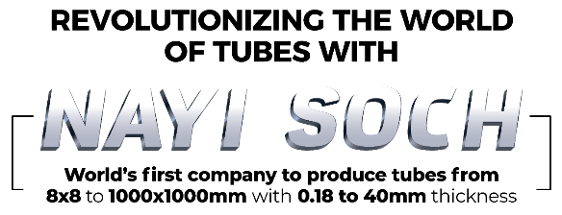
Q2FY24 Earnings Presentation

Slide 2
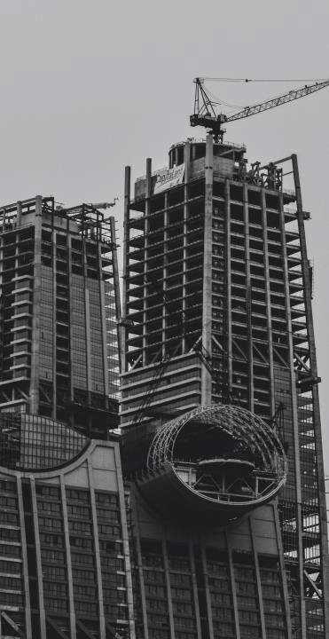
Safe Harbour
Except for the historical information contained herein, statements in this presentation and the subsequent discussions, which include words or phrases such as "will", "aim", "will likely result", "would", "believe", "may", "expect", "will continue", "anticipate", "estimate", "intend", "plan", "contemplate", seek to", "future", "objective", "goal", "likely", "project", "should", "potential", "will pursue", and similar expressions of such expressions may constitute "forward-looking statements“. These forward looking statements involve a number of risks, uncertainties and other factors that could cause actual results to differ materially from those suggested by the forward-looking statements. These risks and uncertainties include, but are not limited to our ability to successfully implement our strategy, our growth and expansion plans, obtain regulatory approvals, our provisioning policies, technological changes, investment and business income, cash flow projections, our exposure to market risks as well as other risks. The Company does not undertake any obligation to update forward-looking statements to reflect events or circumstances after the date thereof.
APL APOLLO TUBES

Slide 3
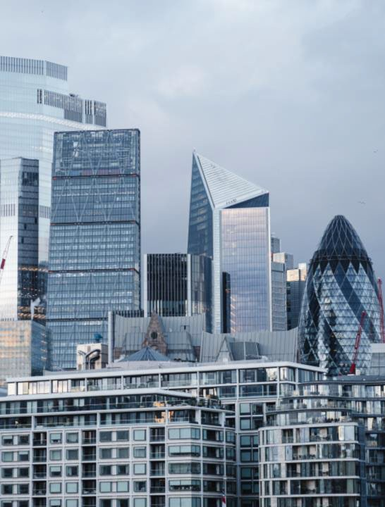
Contents
Q2FY24 at glance
Financial Performance
Business Strategy
New Initiatives
ESG Engagement
Team APL Apollo
APL APOLLO TUBES

Slide 4
Q2FY24 at a Glance
675k Ton
Sales Volume
12% yoy increase
₹ 46.3 Bn
Revenue
17% yoy increase
₹3.3Bn
EBITDA
40% yoy increase
₹ 4,817
EBITDA/ton
25% yoy increase
55%
Value Added Sales mix
Q2FY23 was 54%
₹266 Mn
Interest Cost
96% yoy increase
₹ 2.4Bn
Cash profit
37% yoy increase
₹ 2.0Bn
Net profit
35% yoy increase
APL APOLLO TUBES
5 days
Net WC days*
FY23 was 5 days
32.4%
ROCE*
FY23 was 29.2%
25.2%
ROE*
FY23 was 23.5%
₹2.2Bn
Net debt in H1FY24
FY23 was Rs 2.4 Bn
NWC , ROE, ROCE has been annualized on H1FY24 basis
Note1: Sales Volume and Financials are on consolidated basis
Note 2: Capital employed has been calculated as Total assets minus total current liabilities minus surplus cash

Slide 5
Highest ever Quarterly Sales Volume/EBITDA/ Net Profit
Profit & Loss (Rs Mn) | Q1FY22 | Q2FY22 | Q3FY22 | Q4FY22 | Q1FY23 | Q2FY23 | Q3FY23 | Q4FY23 | Q1FY24 | Q2FY24
Sales Volume (k Ton) | 373 | 427 | 403 | 552 | 423 | 602 | 605 | 650 | 662 | 675
Revenue | 25,343 | 30,839 | 32,304 | 42,147 | 34,386 | 39,692 | 43,271 | 44,311 | 45,449 | 46,304
EBITDA | 2,547 | 2,222 | 2,023 | 2,661 | 1,939 | 2,319 | 2,729 | 3,229 | 3,072 | 3,250
EBITDA/ton (Rs) | 6,825 | 5,199 | 5,023 | 4,823 | 4,587 | 3,850 | 4,510 | 4,970 | 4,645 | 4,817
Net Profit | 1,684 | 1,461 | 1,279 | 1,766 | 1,207 | 1,502 | 1,692 | 2,018 | 1,936 | 2,029
APL APOLLO TUBES

Slide 6
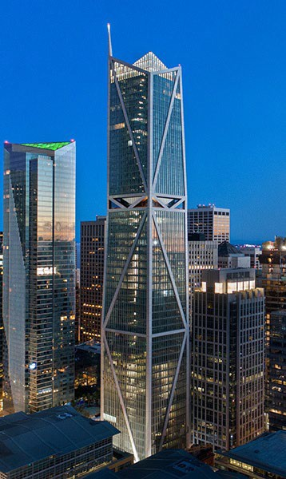
FINANCIAL PERFORMANCE
APL APOLLO TUBES

Slide 7
De-commoditizing Product Portfolio
 | Application | Q2FY23 |  |  | Q3FY23 |  |  | Q4FY23 |  |  | Q1FY24 |  |  | Q2FY24
 |  | Sales Mix | Vol. | EBITDA/Ton | Sales Mix | Vol. | EBITDA/Ton | Sales Mix | Vol. | EBITDA/Ton | Sales Mix | Vol. | EBITDA/Ton | Sales Mix | Vol. | EBITDA/Ton
 |  | (%) | (K Ton) | (Rs) | (%) | (K Ton) | (Rs) | (%) | (K Ton) | (Rs) | (%) | (K Ton) | (Rs) | (%) | (K Ton) | (Rs)
Apollo Structural | Heavy | 7 | 41 | 6,926 | 8 | 46 | 7,568 | 6 | 39 | 8,437 | 7 | 45 | 7,711 | 8 | 51 | 8,481
 | Super Heavy | 0 | 0 |  | 0 | 0 |  | 0 | 2 | 9,604 | 1 | 4 | 8,777 | 1 | 5 | 10,014
 | Light | 18 | 109 | 5,344 | 22 | 132 | 4,059 | 17 | 108 | 6,256 | 17 | 111 | 5,775 | 17 | 113 | 6,258
 | General | 46 | 276 | 1,388 | 44 | 264 | 2,284 | 46 | 299 | 2,579 | 43 | 282 | 2,252 | 45 | 301 | 2,152
Apollo Z | Rust-proof | 23 | 137 | 6,816 | 21 | 125 | 7,492 | 25 | 163 | 7,327 | 26 | 170 | 6,749 | 21 | 144 | 6,721
 | Coated | 2 | 12 |  | 2 | 10 |  | 1 | 10 | 4,424 | 3 | 19 | 4,044 | 4 | 29 | 7,472
Apollo Galv | Agri/Industrial | 4 | 27 | 4,966 | 5 | 28 | 5,659 | 4 | 27 | 6,780 | 5 | 30 | 6,196 | 5 | 32 | 7,196
Total |  | 100 | 602 | 3,850 | 100 | 605 | 4,510 | 100 | 650 | 4,970 | 100 | 662 | 4,645 | 100 | 675 | 4,817
Standard products with EBITDA around Rs 2,000/ Ton
Value added products with EBITDA more than Rs 5,000/Ton
*ABPL (New Raipur) products have been re-classified in heavy, Super Heavy, Light and Coated Products

Slide 8
De-commoditizing Product Portfolio
Product Category | Application | FY20 |  |  | FY21 |  |  | FY22 |  |  | FY23 |  |  | H1FY24 |  |  | Existing capacity | Proposed Capacity
 |  | Sales Mix | Vol. | EBITDA/Ton | Sales Mix | Vol. | EBITDA/Ton | Sales Mix | Vol. | EBITDA/Ton | Sales Mix | Vol. | EBITDA/Ton | Sales Mix | Vol. | EBITDA/Ton | (KTon) | (KTon)
 |  | (%) | (KTon) | (Rs) | (%) | (KTon) | (Rs) | (%) | (KTon) | (Rs) | (%) | (KTon) | (Rs) | (%) | (K Ton) | (Rs)
Apollo Structural | Heavy | 6 | 101 | 4,000 | 6 | 95 | 4,721 | 7 | 121 | 7,422 | 7 | 160 | 7,505 | 7 | 96 | 8,121 | 300 | 396
 | Super Heavy | - |  |  | - |  |  | - |  |  | 0 | 2 | 9,604 | 1 | 9 | 9,422 | 100 | 186
 | Light | 8 | 134 | 4,778 | 21 | 352 | 5,649 | 19 | 336 | 6,683 | 18 | 407 | 5,134 | 17 | 223 | 6,019 | 905 | 1,500
 | General | 55 | 898 | 1,361 | 43 | 713 | 1,658 | 37 | 647 | 2,212 | 44 | 1,005 | 2,015 | 44 | 583 | 2,200 | 1,200 | 1,473
Apollo Z | Rust-proof | 25 | 401 | 5,279 | 25 | 409 | 6,692 | 33 | 575 | 7,710 | 25 | 567 | 7,214 | 23 | 313 | 6,736 | 675 | 825
 | Coated | - |  |  | - |  |  | 0 | 0 |  | 2 | 39 | 5,731 | 4 | 48 | 6,089 | 300 | 300
Apollo Galv | Agri/Industrial | 6 | 99 | 3,952 | 4 | 71 | 6,040 | 4 | 76 | 6,442 | 4 | 99 | 5,667 | 5 | 63 | 6,711 | 120 | 320
Total |  | 100 | 1,633 | 2,923 | 100 | 1,640 | 4,138 | 100 | 1,755 | 5,386 | 100 | 2,280 | 4,481 | 100 | 1,336 | 4,731 | 3,600 | 5,000**
Standard products with EBITDA around Rs 2,000/ Ton
Value added products with EBITDA more than Rs 5,000/Ton
*ABPL (New Raipur) products have been re-classified in heavy, Super Heavy, Light and Coated Products
** proposed capacity of 5Mn Ton to be completed by FY25

Slide 9
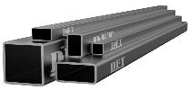















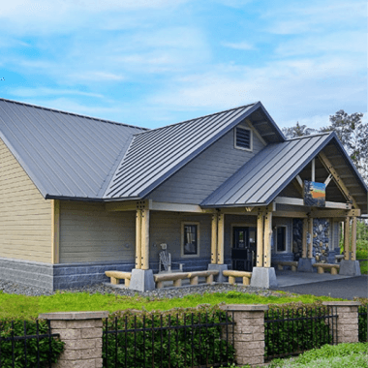




Diversified product offering created through continuous innovation
Product Category | Application | Product – visual overview | Key USPs | Applications | Applications – visual overview
Apollo Structural | Heavy |  | First company to introduce DFT technology in India | High-rise, Warehousing, Infrastructure
 | Super Heavy |  | Offers columns of 300mm x 300mm, 500mm x 500mm and 1000mm x 1000mm* | Column, Beams, Heavy structural erections
 | Light |  | First company in India to introduce Door frame and Plank Light weight tubes for furniture | Door Frame, Staircase Steps, Furniture & fencing Electrical Conduits
 | General |  | First company in India to introduce square, rectangular structural steel tubes | Sheds & Gates, Handrails & Fencing, Balcony Grills Staircase etc.
 | Rust-proof |  | First company in India to introduce pre-galvanized sections, replacing galvanized tubes Effective in use in coastal markets | Roofing Structures, Fabrication Work, Purlins Rafters
Apollo Z
 | Coated |  | High tensile light structural application; bendable; superior rust proof properties | Warehousing Factory Sheds
Apollo Galv | Agri/Industrial |  | Effective for use in water applications, being highly non-corrosive in nature | Greenhouse structures Plumbing Firefighting
APL APOLLO TUBES
Value added products with EBITDA more than Rs 4,000/Ton

Slide 10
Global Peer Benchmarking
162
19%
17%
APL Apollo
14%
106
185
6%
SSAB
68
Maruichi
Zekelman
SSAB
Maruichi Zekelman
EBIDTA Margin (%)
APL Apollo
Revenue (Rs Bn)
APL APOLLO TUBES
3.6
2.8
60%
60%
80%
97%
1.1
1.4
SSAB Maruichi Zekelman APL Apollo
Manufacturing Capacity (mn ton)
Based on latest financial available data
SSAB
Maruichi Zekelman APL Apollo
Building Material and Infrastructure Sales (% of Revenue)

Slide 11
Growing Strength to Strength
APL APOLLO TUBES
Sales Volume and Financials are on consolidated basis
EBITDA has been calculated without other income

Slide 12
Growing Strength to Strength
APL APOLLO TUBES
Note1: Capital employed for ROCE is computed as Total assets less Current Liabilities & Cash
Note 2: ROE/ ROCE has been annualized on H1FY24 basis

Slide 13
Growing Strength to Strength
APL APOLLO TUBES

Slide 14
Growing Strength to Strength
APL APOLLO TUBES

Slide 15
Profit & Loss Statement (Consol)
Particulars (Rs Mn) | Q2FY23 | Q3FY23 | Q4FY23 | Q1FY24 | Q2FY24 | FY23 | H1FY24
Sales Volume (K Ton) | 602 | 605 | 650 | 662 | 675 | 2,280 | 1,336
Net Revenue | 39,692 | 43,271 | 44,311 | 45,449 | 46,304 | 1,61,660 | 91,753
Raw Material Costs | 34,747 | 37,693 | 37,823 | 39,207 | 39,784 | 1,40,178 | 78,991
Employee Costs | 468 | 554 | 595 | 604 | 627 | 2,062 | 1,232
Other expenses | 2,158 | 2,296 | 2,665 | 2,565 | 2,642 | 9,204 | 5,208
EBITDA | 2,319 | 2,729 | 3,229 | 3,072 | 3,250 | 10,215 | 6,322
EBITDA/ton (Rs) | 3,850 | 4,510 | 4,970 | 4,645 | 4,817 | 4,481 | 4,731
Other Income | 116 | 93 | 180 | 217 | 196 | 472 | 413
Interest Cost | 136 | 186 | 249 | 271 | 266 | 671 | 538
Depreciation | 276 | 345 | 468 | 409 | 413 | 1383 | 823
Tax | 521 | 598 | 673 | 672 | 738 | 2,214 | 1,410
Net Profit | 1,502 | 1,692 | 2,018 | 1,936 | 2,029 | 6,419 | 3,965
APL APOLLO TUBES
Note 1: Sales Volume and Financials are on consolidated basis
Note 2: Trading revenue for Q2FY24 was Rs.843 Mn

Slide 16
Balance Sheet & Cash flow(Consol)
Balance Sheet - Assets (Rs mn) | H1FY24 | FY23 |  | Cashflow Statement (Rs mn) | H1FY24 | FY23
Cash & Bank Balance | 9,340 | 6,295 |  | EBITDA | 6,322 | 10,215
Receivables | 1,445 | 1,374 |  | Change in receivables | -65 | 1,990
Inventories | 13,633 | 14,799 |  | Change in inventory | 1158 | -6340
Other current assets | 3,231 | 3,110 |  | Change in other WC | -2,109 | 5,494
Fixed assets (net) | 29,781 | 27,232 |  | Tax | -916 | -2,161
Right to use Assets | 1064 | 925 |  | Others/ Income | 413 | 472
Investments | 481 | 960 |  | Operating cash flow | 4,803 | 9,670
Other assets/goodwill | 4,022 | 3,821 |  | Capex | -3,564 | -8,424
Total Assets | 62,997 | 58,516 |  | Investments | 600 | -222
Balance Sheet - Liabilities (Rs mn) | H1FY24 | FY23 |  | Interest | -453 | -602
Trade payables | 13,201 | 15,970
 |  |  |  | Free cash flow | 1386 | 423
Other current liabilities | 2,596 | 1,185 |  | Dividend payments | -1387 | -875
Debt | 11,552 | 8,729 |  | Capital increase | 0 | 27
Others | 2,844 | 2,576 |  | Others | 222 | 32
Minority Interest | 0 | 0 |  | Net change in cash flow | 221 | -393
Shareholders' funds | 32,803 | 30,056 |  | Net debt beginning | -2,434 | -2,042
Total Equity & Liabilities | 62,997 | 58,516 |  | Net debt end | -2,213 | -2,434
APL APOLLO TUBES
* Rs 2.27bn FD is classified under Other financial Assets due to maturity of less than 365days

Slide 17

Consol. Cash Flow Bridge (Rs Mn.)
APL APOLLO TUBES
Business continues to generate strong operational cash flows
Capex being funded from internal cash flows
Net debt to EBITDA at 0.2x

Slide 18


Capex Plan for value addition
Distribution Enhancement
BUSINESS STRATEGY
APL APOLLO TUBES
Market Creation
Innovation

Slide 19








APL Apollo Vision
MARKET CREATION
INNOVATION
Solid new product pipeline
Complete product portfolio for steel buildings
Innovative processes which improve life of steel
+
ESG
+
Replacement of conventional construction products
  Wood
  Angles/Channels
  RCC
Reach out program for influencers: Fabricators,
Architects, Structural Engineers
Introducing environmentally friendly products
To reduce the emissions by 25% by 2030
Working Towards gender diversity
Focus on CSR towards local
communities
New Code of conduct implemented for all employees
APL APOLLO TUBES

Slide 20

INNOVATION
World’s only company to make steel tubes with size range of 8x8mm to 1000x1000mm and thickness range of 0.18 mm to 40mm
APL APOLLO TUBES

Slide 21
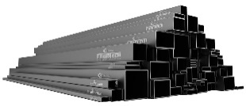


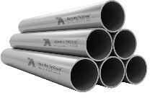
What we have done so far as the first company
Indian Markets
Structural steel square and rectangular tubes:
Structural application in construction Industry
Pre-galvanized structural steel tubes (Apollo Z):
Corrosive resistant structural applications
DFT (Direct Forming Technology)
Faster TAT with tailor made sizes
APL APOLLO TUBES
300x300mm dia structural steel tubes:
Heavy structural application in Construction industry
Inline galvanizing (ILG)
Superior corrosive resistant product strong demand in coastal market

Slide 22


What we have done so far as the first company
Global Markets
Chaukhat (Door frame shape tubes)
Replacing Conventional wooden door frames
Rectangular section of 1:11 (Length to Breadth)
Replacing Conventional wooden sections
APL APOLLO TUBES

Slide 23
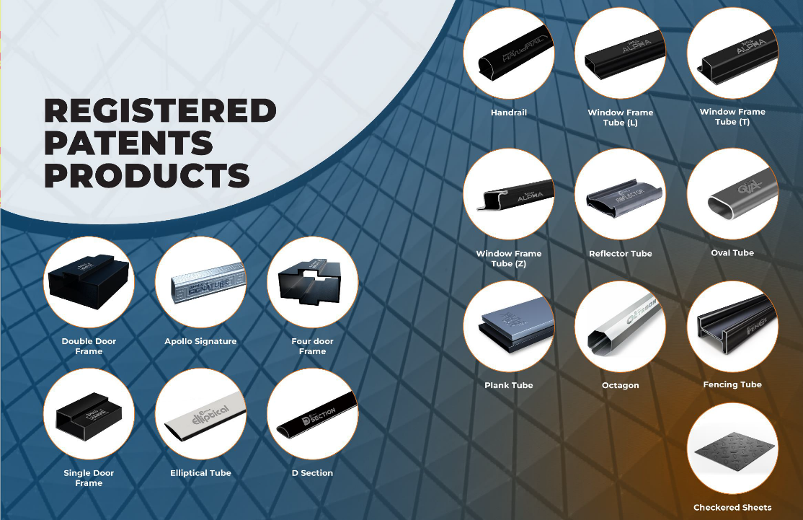
APL APOLLO TUBES

Slide 24



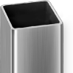
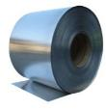

New Product Pipeline from Raipur plant
World’s 1st thicker color coated products
Superior corrosion resistant, high load bearing with aesthetics
World’s 1st Color coated structural steel tubes
Superior corrosion resistant with aesthetics
India’s 1st 500x500mm dia structural steel tubes
Replacing RCC structures/columns in heavy construction
APL APOLLO TUBES
India’s 1st and World’s 2nd 1,000x1,000mm
India’s 1st CRCA Black annealed tube
High tensile light structural application; bendable; superior rust proof properties
India’s 1st AluZinc tubes
Superior rust proof properties and better life

Slide 25
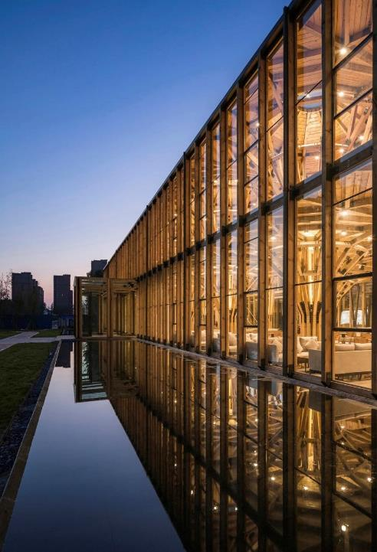
MARKET CREATION
APL APOLLO TUBES

Slide 26
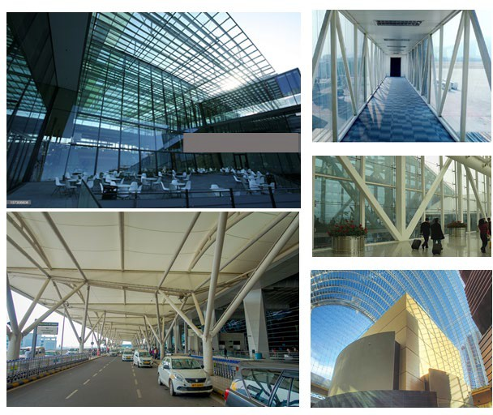
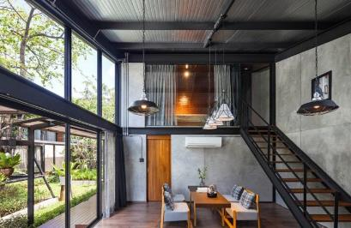
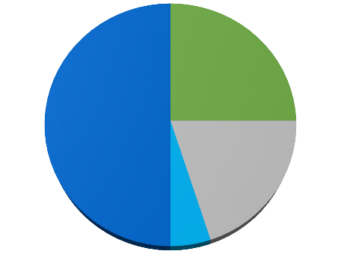
Structural Steel Tube Applications
Application Mix
Commercial Buildings 25%
Housing 50%
APL APOLLO TUBES
Infrastructure 20%
Others 5%
*As per H1FY24 revenue

Slide 27
How Have We Created Market..
Conventional Construction Products | Applications | Why Structural Steel Tube replaces these products?
Steel Angle/Channels | Structural support, Towers infrastructure | Uniform Strength, Lower steel consumption
Wood | Furniture, Door Frames, Planks | Cost Effective, Termite Proof, Environmental Friendly
Aluminum Profiles | Facades & Glazing | Cost Effective, Higher Strength
Reinforced Cement Concrete | Construction of Buildings | Faster Construction Environmental Friendly
Fabricated Metal Sheet | Pre-Engineered Steel Buildings | Lower steel consumption Reduces overall project cost
How to replace the conventional products??
Low Diameter Steel Tubes/Low Load
Bearing
APL APOLLO TUBES
High Diameter Steel Tubes/High Load Bearing

Slide 28
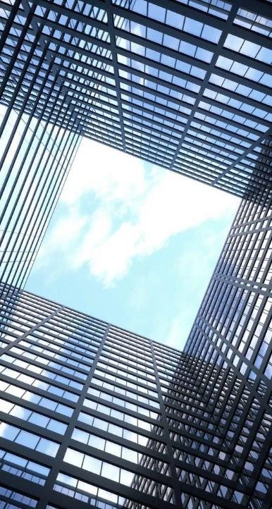
REVOLUTIONIZING CONSTRUCTION INDUSTRY
APL APOLLO TUBES

Slide 29


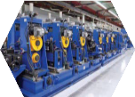
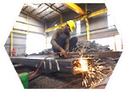
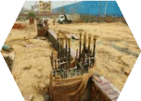
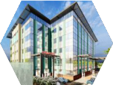


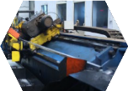
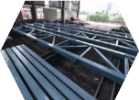
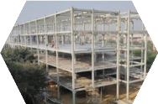
Tubular Construction Process flow
Tube Manufacturing
Fabrication
Tubes are sand blasted, then connected using
connectors
Civil Foundation
Hospital Building
Hospital
Production of 6,000 ton ERW tubes per day at plants of APL
Apollo
Civil Foundation & Arrangement of anchor bolts at site to install
tube columns
Transfer of cut to length tubes to Fabricator’s workshop
Transfer of structure parts to the site
APL APOLLO TUBES
CTL Line
Cutting of tubes into desired length at APL Apollo plant to minimise
wastages
Painting
Connected structures are
painted
Site Erection
Zero on-site fabrication/Welding; Erection using bolting connections

Slide 30
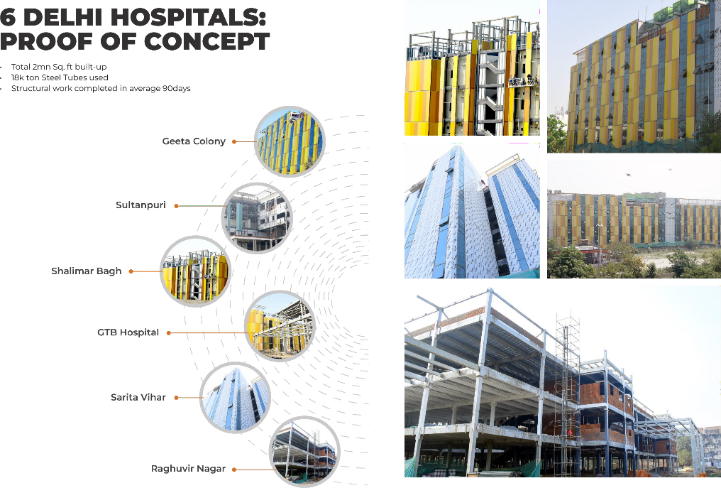
APL APOLLO TUBES

Slide 31
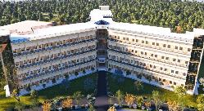
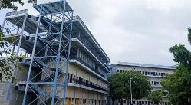
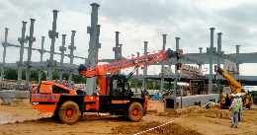
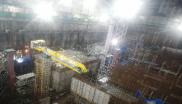
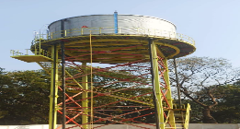
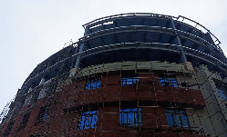
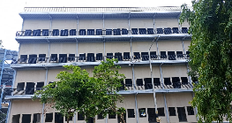
More live sites
MES – Delhi Cantonment
University Campus- Telangana
APL APOLLO TUBES
Railway Station – Andhra Pradesh
Hospital- Mumbai
Water Tank, Uttar Pradesh
University, Delhi NCR
Housing-Delhi

Slide 32
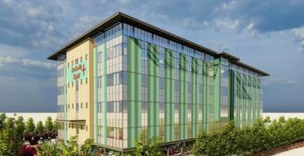
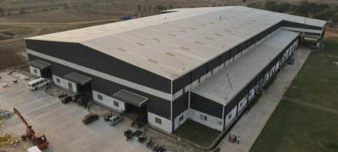
Applications
High Rise Buildings
  Hospitals, Housing, Schools, Courts, Hotels/Malls/Offices
Warehouses/Cold Storage/Food Parks
Factory Buildings/Process Structures
Aviation Hangers
Data Centres
220,000 ton
heavy structural steel tubes
45
projects
42mn sq. ft.
Visibility
Ongoing enquiries
APL APOLLO TUBES

Slide 33
Vision 2025
Dominant position with 60%+ market share
Company aims to continue its dominant position in Indian Market
Capacity: 5 Mn Tons with Capacity Utilization of 80%+
1
Product innovation
Create formidable position in newer product category (Super Heavy and Coated)
Revenue 2X
2
Strengthen presence in Global Markets
Aim to enhance global presence and have 10% share of the overall sales
EBITDA 2.5X
3
APL APOLLO TUBES
Customer Centricity
With Investment in B2C app, use of Bollywood and Sports for brand pull, we have strong focus on customer centricity
70%+ revenue from Value Added Products
4
Recognized Player on ESG Front
Significant focus on ESG
10%+ of sales from Exports
5

Slide 34



Growth Drivers
A
Capacity expansion
B
New products
C
Focus on high margin products
D
Geographic expansion
Raipur project
Capacity: 1.2 MTPA (infrastructure of 1.5 MTPA)
Capex: Rs13bn (90% already incurred)
Potential financials:
  Revenue: Rs70bn+
  EBITDA: Rs6bn+
Products
Project specifically focused at High- value added products 3 key product categories:
High Diameter High Thickness Tubes
500m x 500m and 1000m x 1000m
Capacity: 0.5 MTPA
Suitable for high rise, high load bearing structures
Reduces project cost by ~20% for the developer
Coated Tubes
Colored and galvanized
Capacity: 0.3 MTPA
Suitable for Warehousing, infrastructure & industrial segments
Coated Products
Narrow cold rolled and flat products
Capacity: 0.4 MTPA
New age products to replace existing products of wood, PVC etc.
East India
Capacity: 0.2 MTPA
Project to help deeper penetration in the Eastern India market
Land acquisition in process
COD: FY 25
Dubai
Capacity: 0.4 MTPA
First plant outside India for catering to Middle East and European markets
COD: FY 25
APL APOLLO TUBES

Slide 35


APL Apollo’s ESG Transformation
Journey

Slide 36
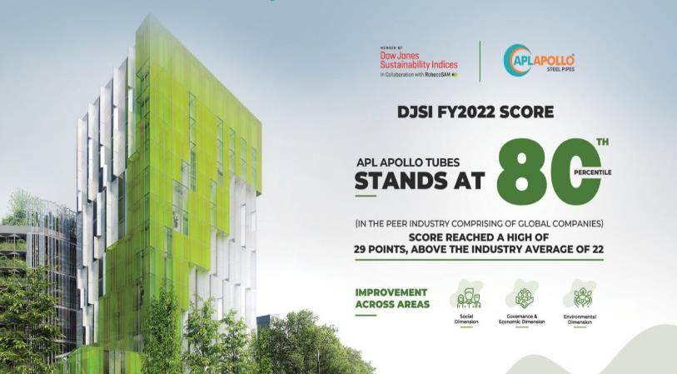
DJSI Scoring
APL APOLLO SCORED 80TH PERCENTILE IN FY22
We expect better score this year as we are improving on ESG parameters
APL APOLLO TUBES

Slide 37
Commitment and achievements
Commitments
Achievements
E E
Introduced new, environmentally friendly products
E
Committed to reducing Scope 1&2 emissions by 25% by 2030
Committed to set near term and Net Zero targets by 2050
All plants have access to green energy, 2 plants have more
than 85% dependency on green energy E
Renewable energy contribution to be 47% by 2030 from 38%
Targeted to increase the female workforce by 1% every year
CSR initiatives in the local communities to uplift their lifestyle
E S S
S S S S S
Almost all plants have rainwater harvesting facilities
Zero accidents by providing safety training at sites
Attrition rate below 5%
Hiring female workforce to achieve gender diversity targets
Given emphasis to CSR initiatives in local communities
APL APOLLO TUBES
Skill development trainings and safety trainings
Occupational Health and safety assessment of all work force
S S
Training on code of conduct to educate each employee
G
New Code of conduct implemented for all employees
G

Slide 38
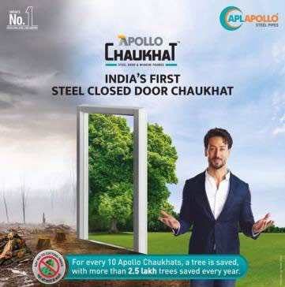

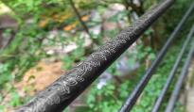
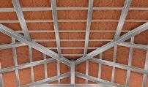
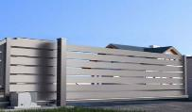
Front runner for Steel for Green
APL Apollo is the 1st Company to innovate readymade Doorframe, Fence, Plank and Hand rails as Steel for Green Concept which replaced conventional wood application in building construction
Our Products are saving 250,000 trees every year, going ahead we will be saving more and more trees to keep the planet greener
Keeping the Steel for Green as priority APL is the 1st Company to innovate narrow and thicker color coated galvanized sheets which will save more trees
APL APOLLO TUBES

Slide 39

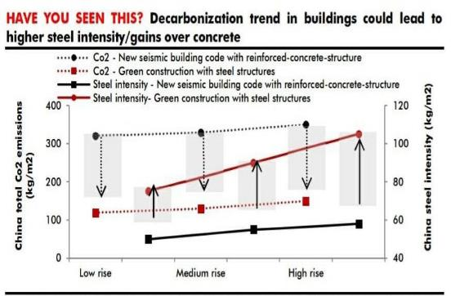
Steel Buildings = Decarbonization
Construction sector contributes 30% of direct and indirect Co2 emissions
Structural steel is preferred for steel buildings because steel is
  Infinitely recyclable
  Easy to pre-fabricate
  High volume to weight ratio
  Lighter/ stronger structure allow gains inn vertical space
Research indicates replacing reinforced concrete with steel structures can reduce emission by 60%
Steel Structure - RCC Structure
APL APOLLO TUBES

Slide 40
Financial Priorities under Strong Governance
Growth
Earnings
Drive sustainable EPS growth Attain earnings objectives across economic cycles
Profitable Organic Growth Commitment to R&D and Talent Innovate products to replace conventional construction methods
APL APOLLO TUBES
Capital Allocation
Drive sustainable EPS growth
Attain earnings objectives across economic cycles Achieve ROCE ≥ 30%

Slide 41




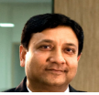



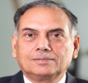
Board of Directors
Sanjay Gupta
CMD
Steel Industry veteran with 3 decades ofexperience
Deepak Goyal
Group CFO
& Director-Operations
2 decades of professional experience in steel tube industry
Neeru Abrol
Director at TCNS Clothing Co Limited & others|Awarded best achiever by ICAI | 26 Yr experience in SAIL
Ashok Kumar Gupta
Steel industry veteran with 4 decades of experience Worked as MD in APL Apollo in the past
Abhilash Lal
3 decades of professional experience in senior roles across financial services including banking, PE & others
Rahul Gupta
A promising entrepreneur with an experience of around 5 years in Steel Tubes Manufacturing
APL APOLLO TUBES
Anil Kumar Bansal
Director of NABARD, Rockland Finesto Ltd & others
4 decades of experience in banking industry
Vinay Gupta
More than 20 years of industry experience in the manufacturing and trading pipes, tubes and sheets.
Virendra Singh Jain
Board member of Dalmia Bharat Ltd|Ex-Chairman of SAIL|Ex- Executive Director at IOC

Slide 42
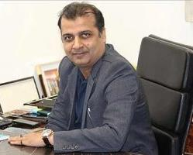
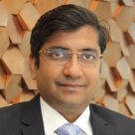

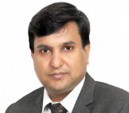
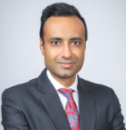
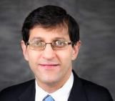
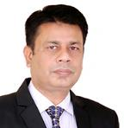
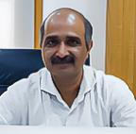
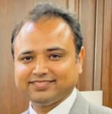
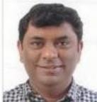
Our Leadership
Vinay Gupta
Chairman
Apollo Metalex
Rahul Gupta
JMD
Apollo Building Products (New Raipur)
Deepak Goyal
Group CFO
& Director-Operations
Anubhav Gupta
Group Chief Strategy Officer
Sanjay Gupta
CMD
APL APOLLO TUBES
Anurag Mehrotra
Chief Human Resource Officer
CK Singh
VP - Operations
Ravindra Tiwari
Head-Sales & Marketing
Utkarsh Dwivedi
CEO
International Business
Amit Thakur
Head Procurement

Slide 43

Thank You
For further information, please contact:
Anubhav Gupta
APL Apollo Tubes Ltd
Tel: +91 120 404 1452
Email: anubhav@aplapollo.com
Deepak Goyal
APL Apollo Tubes Ltd
Tel: +91 120 404 1400
Email: deepakgoyal@aplapollo.com
APL APOLLO TUBES
Shubham Mittal
APL Apollo Tubes Ltd
Tel: +91 120 404 1453
Email: shubhammittal@aplapollo.com

